Slide 1
Supervised Image Classification Using an Artificial Neural Network for Optical Digit Recognition and Diagnosis of Fine Needle Aspirates of Breast Cancer
Somil Govani

Slide 2

The Multivariate Conundrum
Linear or limited-variable functions are easy to evaluate
Learning problems of classification and continuous predictions become difficult
Humans are particularly good at this

Slide 3
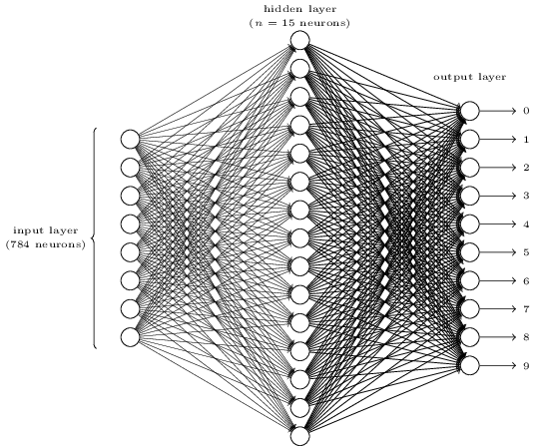
Artificial Neural Networks (ANN)
Machine Learning model loosely inspired by biological structure of brain
Takes inputs, transforms and weights, gives outputs

Slide 4
Training & Learning Model
Training algorithm uses supervised data to set weights
Constructs an approximate multivariate function

Slide 5
Practical Applications
Optical Character Recognition (OCR)
Stock Market Prediction Analysis
Travelling Salesman Problem (TSP)
Other multivariate fuzzy predictions
Image Classification (Digits, Medical Images, etc.)

Slide 6
Goal
To develop a general-purpose, extensible artificial neural network for the supervised analysis and classification of images. To apply this ANN for Optical Digit Classification and categorical diagnosis of fine needle aspirates of breast cancer tumors.

Slide 7
Network Class Constructor
Hidden Layer
y
x
Input Layer
x
y
Output Layer
x
y

Slide 8
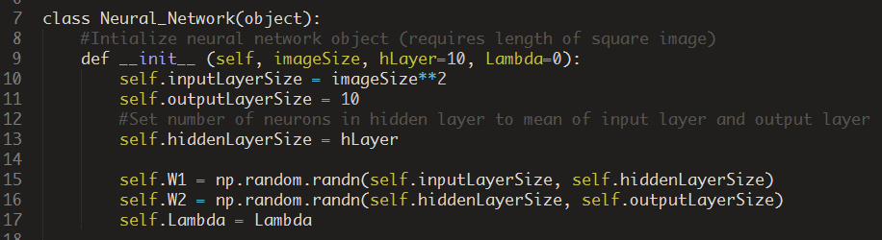
Network Class Constructor

Slide 9
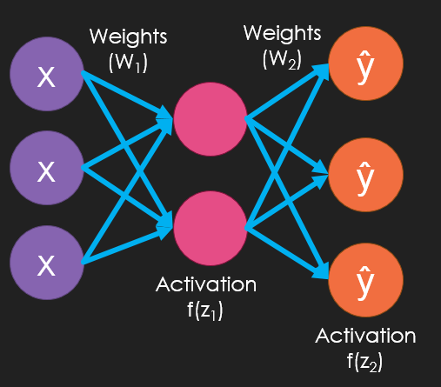
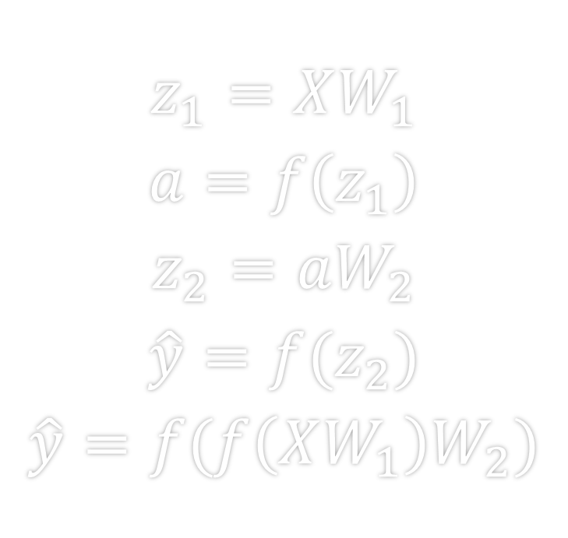
Forward Propagation
$$z_{1}=XW_{1}$$
$$a=f\left(z_{1}\right)$$
$$z_{2}=aW_{2}$$
$$\hat{y}=f(z_{2})$$
$$\hat{y}=f(f\left(XW_{1}\right)W_{2})$$

Slide 10
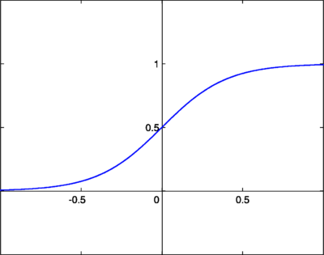


Sigmoid Activation Function f(z)
Differentiable and introduces non-linear attributes
$$f\left(z\right)=\frac{1}{1+e^{−z}}$$
$$f′\left(z\right)=\frac{e^{−z}}{{\left(1+e^{−z}\right)}^{2}}$$

Slide 11
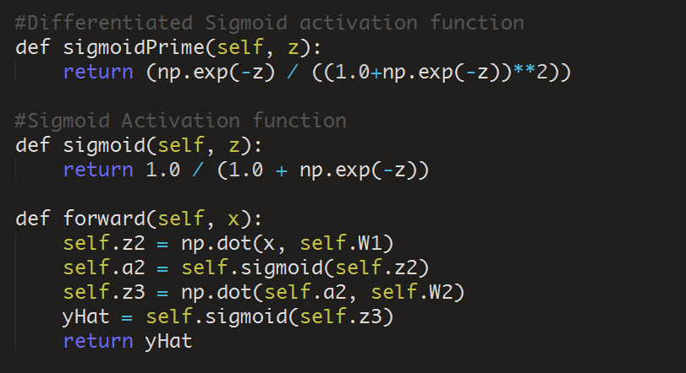
Forward Propagation Method

Slide 12
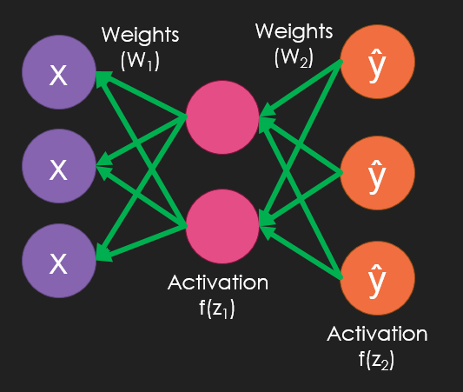
Backwards Propagation
Goal is tune weights in order to minimize the error of predicted outputs
Use differential analysis to compute gradients

Slide 13
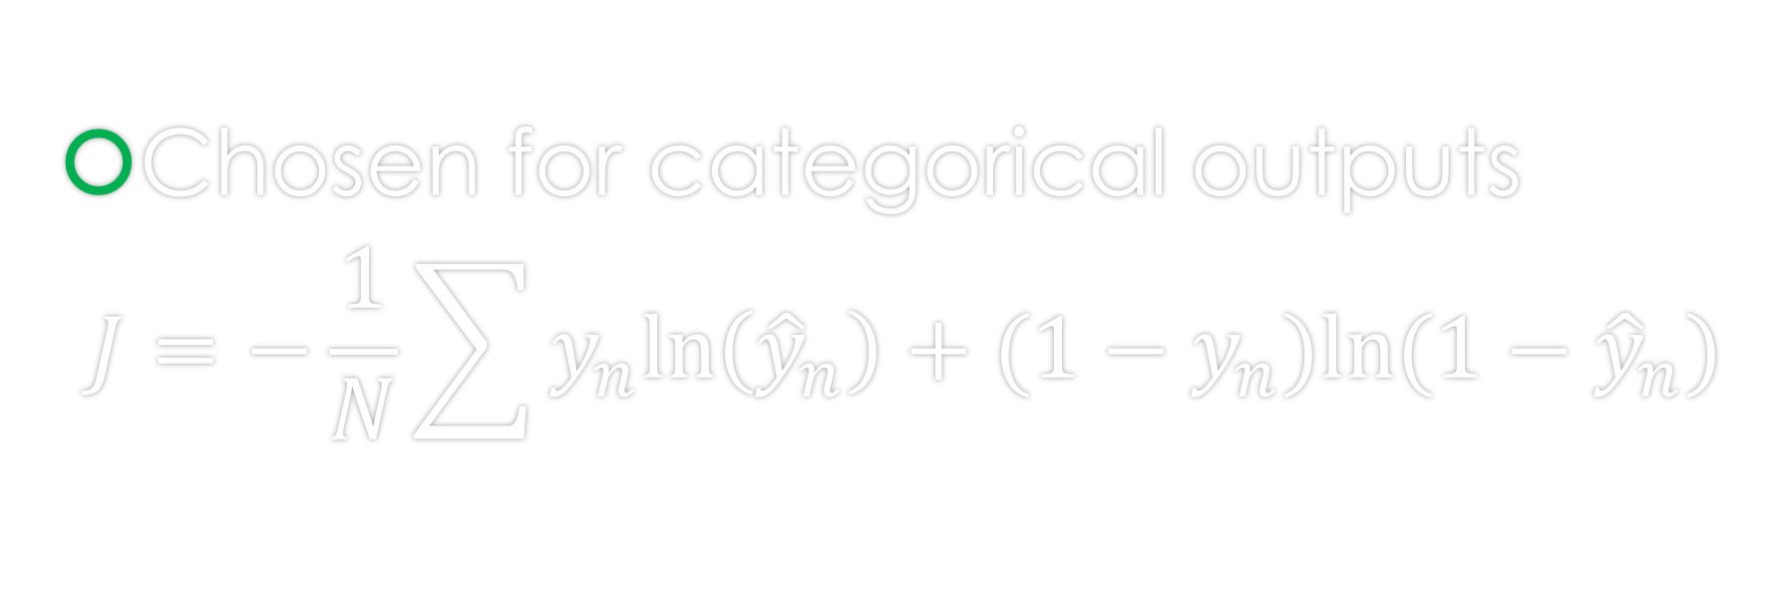
Cross Entropy Cost Function
Chosen for categorical outputs
$$J=−\frac{1}{N}\sum{y_{n}ln\left({\hat{y}}_{n}\right)+(1−y_{n})ln⁡(1−{\hat{y}}_{n})}$$
Compute Cost for Incorrect Nodes
Compute Average
Compute Cost for Correct Node

Slide 14

Minimizing Cost using a Computed Gradient
Iteratively computes gradient of cost function
Approximates Newton’s Method and alters weights to approach minimum of cost function
Use gradient to move in negative direction
$$∇J=\left(\frac{∂J}{∂W_{1}},\frac{∂J}{∂W_{2}}\right)$$

Slide 15







Computing Partial Derivative of Cost Function in Respect to W₂
$$J=−\frac{1}{N}\sum{y_{n}ln\left({\hat{y}}_{n}\right)+(1−y_{n})ln⁡(1−{\hat{y}}_{n})}$$
$$\frac{∂J}{∂W_{2}}=−\frac{1}{N}\sum{\left[\frac{y}{\hat{y}}−\frac{1−y}{1−\hat{y}}\right]}f^{′}\left(z_{2}\right)a$$
$$\frac{∂J}{∂W_{2}}=−\frac{1}{N}\sum{\frac{y}{\hat{y}}∗\frac{∂\hat{y}}{∂W_{2}}+\frac{1−y}{1−\hat{y}}∗\frac{−∂\hat{y}}{∂W_{2}}}$$
$$\frac{∂J}{∂W_{2}}=−\frac{1}{N}\sum{\left[\frac{y−\hat{y}}{\hat{y}(1−\hat{y})}\right]f^{′}\left(z_{2}\right)}a$$
$$\frac{∂J}{∂W_{2}}=−\frac{1}{N}\sum{\left[\frac{y}{\hat{y}}−\frac{1−y}{1−\hat{y}}\right]}\frac{∂\hat{y}}{∂W_{2}}$$
$$\frac{∂J}{∂W_{2}}=a^{T}∙\frac{\hat{y}−y}{N}$$
$$\frac{∂J}{∂W_{2}}=−\frac{1}{N}\sum{\left[\frac{y}{\hat{y}}−\frac{1−y}{1−\hat{y}}\right]}\frac{∂\hat{y}}{∂z_{2}}\frac{∂z_{2}}{∂W_{2}}$$

Slide 16




Computing Partial Derivative of Cost Function in Respect to W₁
$$J=−\frac{1}{N}\sum{y_{n}ln\left({\hat{y}}_{n}\right)+(1−y_{n})ln⁡(1−{\hat{y}}_{n})}$$
$$\frac{∂J}{∂W_{1}}=−\frac{1}{N}\sum{\left[\frac{y}{\hat{y}}−\frac{1−y}{1−\hat{y}}\right]}\frac{∂\hat{y}}{∂W_{1}}$$
$$\frac{∂J}{∂W_{1}}=−\frac{1}{N}\sum{\left[\frac{y}{\hat{y}}−\frac{1−y}{1−\hat{y}}\right]}\frac{∂\hat{y}}{∂z_{2}}\frac{∂z_{2}}{∂a}\frac{∂a}{∂z_{1}}\frac{∂z_{1}}{∂W_{2}}$$
$$\frac{∂J}{∂W_{1}}=X^{T}∙\left[\frac{\left[\hat{y}−y\right]}{N}{∙W_{2}}^{T}∙f^{′}\left(z_{2}\right)\right]$$

Slide 17
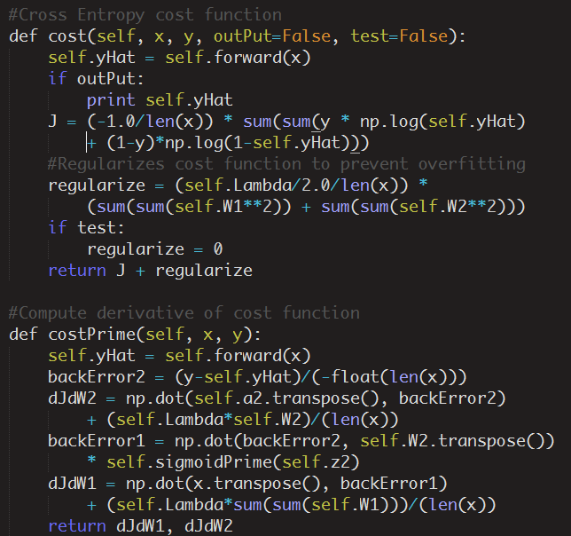

Slide 18
Training
In order to carryout supervised backpropagation, supervised training data is necessary
The more training data the more accurate the approximation
Use training data to minimize cost using BFGS/CG algorithm

Slide 19
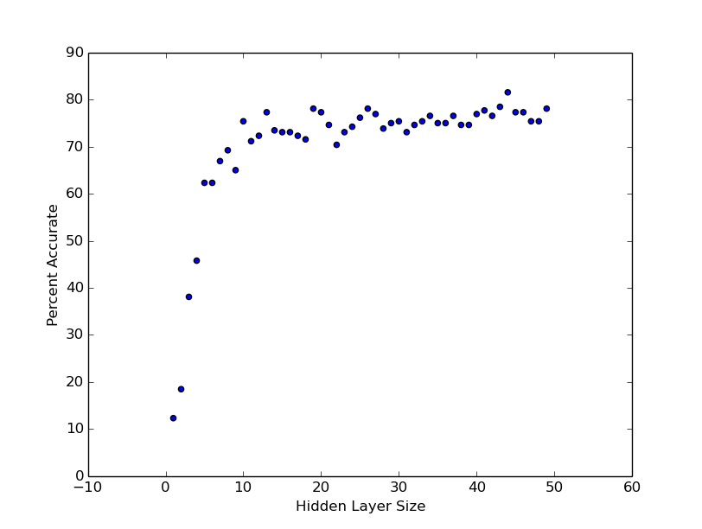
Determining Hyperparameters
% Accuracy vs Hidden Layer Size
Constant iterations and samples
Change is negligible after approximately 10

Slide 20
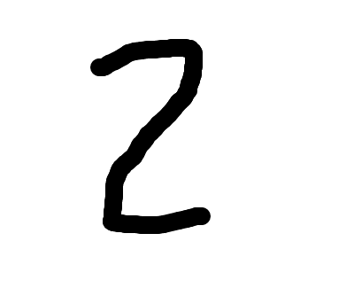
Digit Recognition
Use handwritten digits as training data
Crop and compress image to 16x16 pixels
Input uses 1-of-N encoding (-1 for White, 1 for Black)
Output is vector of length 10 (for each digit)

Slide 21
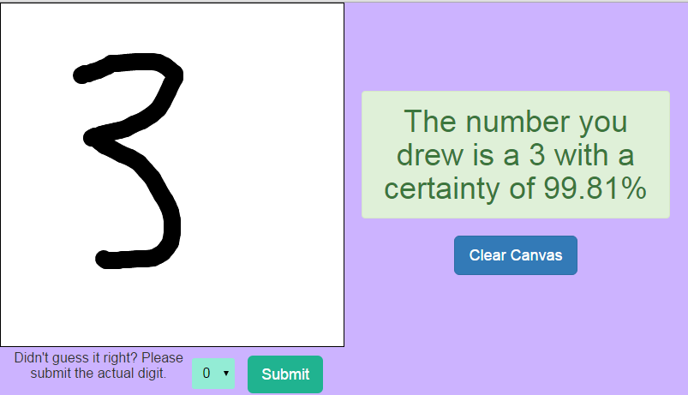
Data Collection
Built application using PyGame
Mostly trained my handwriting
Built cloud-based web application using Django
Crowd-sourced training
Integrated with neural network for forward and backwards propagation

Slide 22
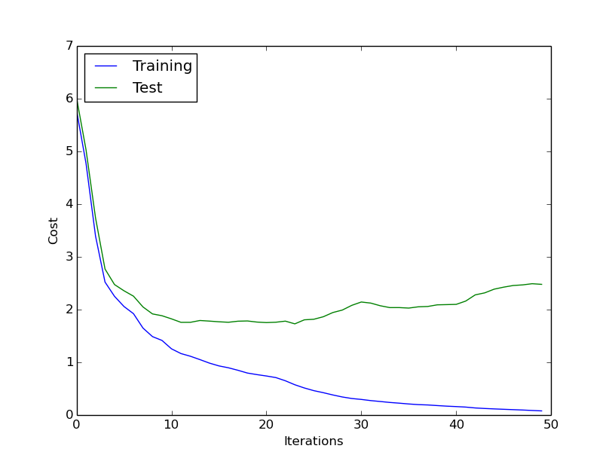
Testing
20% of data used for testing / 80% used for training
Shows some signs of overfitting
Overall accuracy of 82.4% across 1560 trials
Overfitting begins

Slide 23
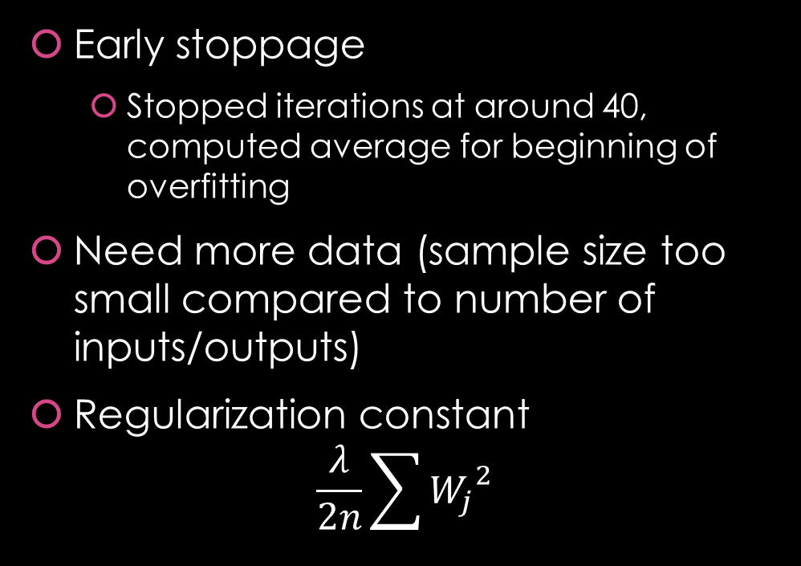
Accounting for Overfitting
Early stoppage
Stopped iterations at around 40, computed average for beginning of overfitting
Need more data (sample size too small compared to number of inputs/outputs)
Regularization constant $\frac{λ}{2n}\sum{{W_{j}}^{2}}$

Slide 24
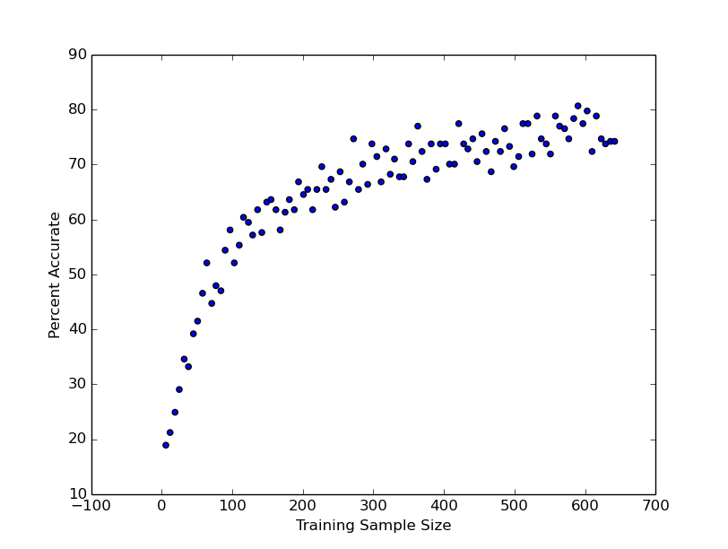
Sample Size versus Percent Accuracy
% Accuracy vs Training Sample Size
Shows logarithmic growth
Shows that an increase of sample size will increase accuracy (overcome overfitting)

Slide 25
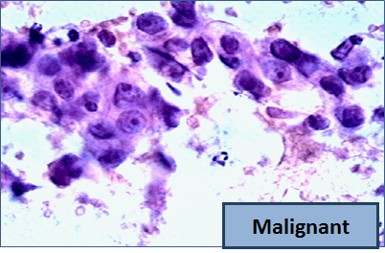
Diagnosis of Fine Needle Aspirates of Breast Tumors
Input data from Breast biopsies from UCI Machine Learning Database
Data consists of many attributes of biopsies (radius, texture, perimeter, smoothness, etc)
Single Output (Benign vs Malignant)

Slide 26
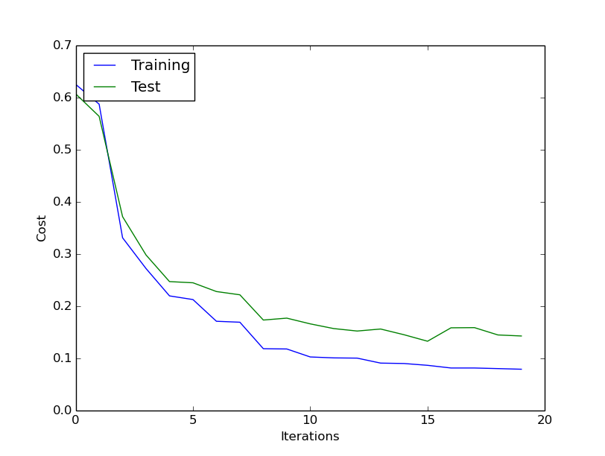
Testing
30% of data used for testing / 70% used for training
Ample amount of data (no signs of overfitting)
Overall accuracy of 97% across 715 trials

Slide 27
Conclusion
Successes
Future Implications
High % accuracy for both sets
Efficient gradient descent
Neural network is extensible
More training data (esp. for ODR)
Bootstrap aggregation of data set (esp. for ODR)
Investigation into more convoluted/deep neural networks

Slide 28
Bibliography
Lichman, M. (2013). UCI Machine Learning Repository [http://archive.ics.uci.edu/ml]. Irvine, CA: University of California, School of Information and Computer Science.
Cernazanu-Glavan, Cosmin, and Stefan Holban. Segmentation of bone structure in X-ray images using convolutional neural network. Timosoara: Politehnica University of Timisoara, n.d. Digital file.
Hagan, Martin T. Neural Network Design. N.p.: Oklahoma State, n.d. Print.
Jenker, Andrej. “Introduction to Artificial Neural Networks.” Artificial Neural Networks - Methodological Advances and Biomedical Applications. Ed. Kenji Suzuki. N.p.: InTech, 2011. N. pag. Digital file.
Rojas, Raul. Neural Networks: A Systematic Introduction. Berlin: Springer, 1996. Digital file.
Zhang, Q. J. Neural Network Structures for RF and Microwave Applications. Orlando: IEEE AP-S Antennas and Propagation Int. Symp., 1999. Digital file.

Slide 29
Supervised Image Classification Using an Artificial Neural Network for Optical Digit Recognition and Diagnosis of Fine Needle Aspirates of Breast Cancer
Somil Govani

